Slide 1
Notes:
Audience Question: What does electrical cuircit design, webpage ranking, portfolio management and quadratic programming all have in common?

Slide 2


Slide 3
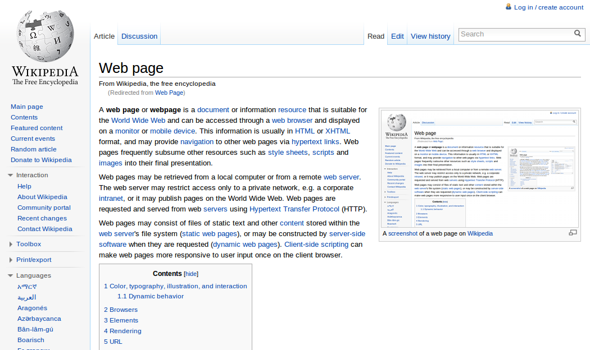

Slide 4


Slide 5
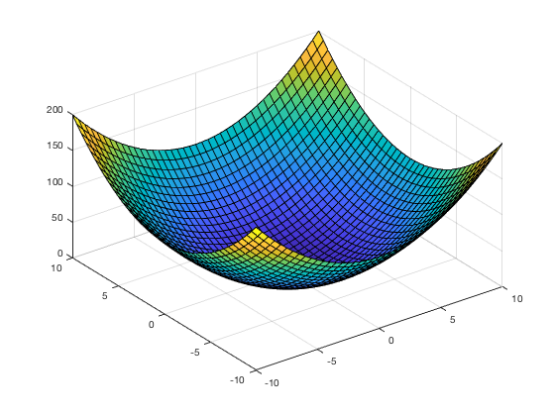

Slide 6
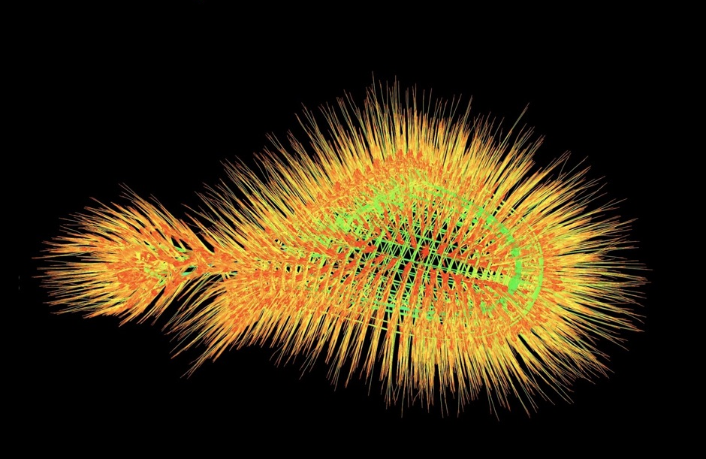
Notes:
To tackle each problem one has to solve some kind of linear systems. And more concretly , one has to solve enormous sparse linear systems with maybe millions of entries and with most entries beeing zero
+ graphical representation

Slide 7
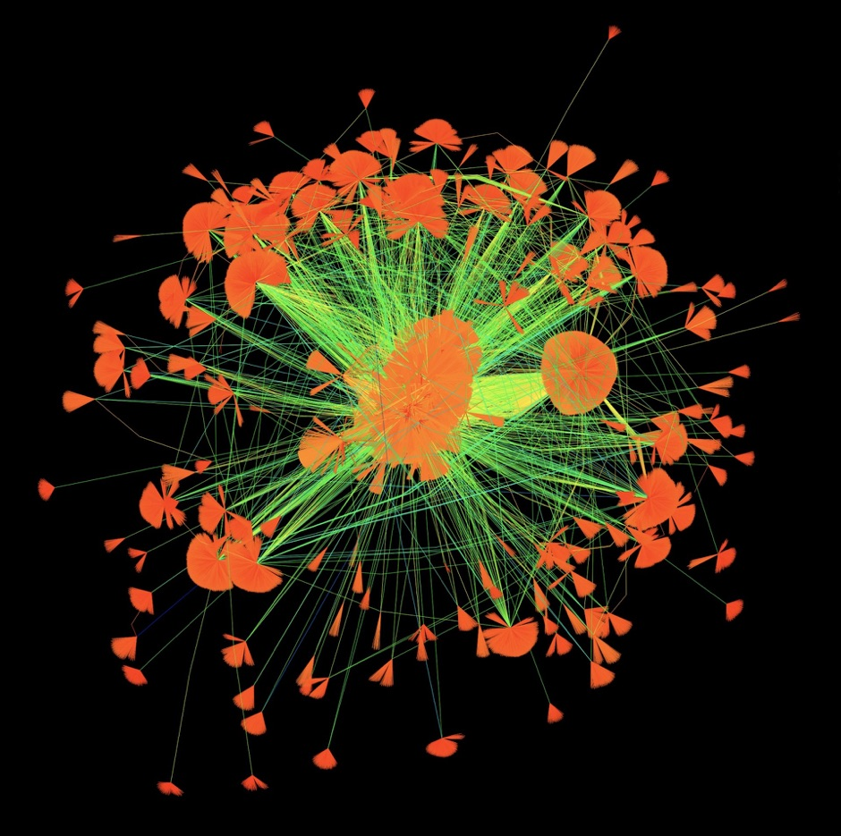

Slide 8


Slide 9
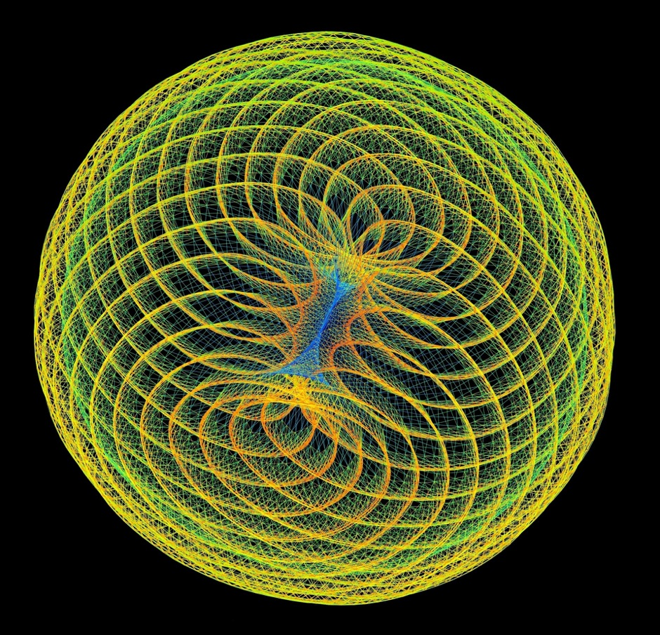
Notes:
Daisy Chain: Financial Portfolio Optimization (2009). Optimizing a financial portfolio leads to a graph with many branches, each depicting a possible future economic scenario. Which path will your portfolio take?
Web Poppies (2009) You like a web page and I like it too. 512 people like 394,792 web pages, do you like them too
reddish-orange frequency-domain circuit simulation matrix constructed via the harmonic-balance method
Convex Quadratic Programming (2009)

Slide 10
Notes:
Gaussian to slow-> iterative solvers which generate an approximate solution .They will start with initial guess and each iteration will calculate an approximate solution where the result of one iteration is derived from the previous result. The solver will stop if a certain stopping criteria such as a maximum amount of iterations is met.

Slide 11
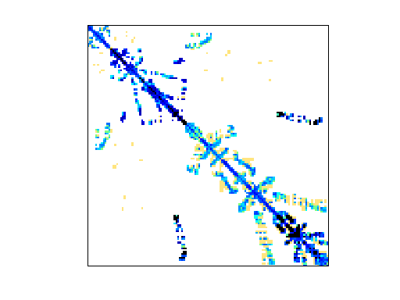

Computational Fluid Dynamics Problem
Economic Problem
Notes:
But a linear system from one problem might differ substantially from the linear system of another problem like you see here with a cuircuit and …
As a consequence some solvers are more suited to solve some kind of problem and others may be more suited to solve a different kind of problem
But determing which solver will solve a given matrix the fastest might generally not be very obvious. And that is where our software gets involved

Slide 12
.. Our approach solves this issue
Explain or product
The 4 modules
Overview(picture)
We used ginkgo…

Slide 13
collector

Slide 14
´labeling module

Slide 15
Traning module

Slide 16
Classifier

Slide 17
Now we can get into details if we have time
Output service
Usage of our product
Statistics(loc,coverage,accuracy of nn…)

Slide 18
reflection
Challenges
How we solved them
How much of the mandetory/optional requirements we achieved

Slide 19
outlook
What we could add

